Slide 1
Predictive Modeling and Explainable AI for Autism Spectrum Disorder Diagnosis
Advisor: Dr. Amir Jafari and Dr. Gabriela Rosenblau
Students: Anirudh Rao, Ramana Bhaskar Kosuru, Wilona Nguyen

Slide 2
Problem Statement
How can interpretable, multi-modal machine learning models that integrate behavioral and linguistic data improve the diagnostic precision, subtype discovery, and generalizability of Autism Spectrum Disorder (ASD) prediction?

Slide 3
Objective
Extract insights from unstructured text data
Implement feature importance analysis
Improve autism diagnosis accuracy
Create generalize models
Identify autism subclusters
Develop explainable AI framework

Slide 4
Raw Data Description - Data V1
Provided by Department of Psychological & Brain Sciences
1119 subjects (ages 8-12Y)
sub | Participant ID
td_or_asd | Is this participant classified as TD (Typically Developing) or ASD (Autism Spectrum Disorder)? 0 = TD, 1 = ASD
profile | TDprof_norm, ASDprof_norm, or ASDprof_unif. These represent the preference profiles of the 3 kids that participants learned about. Participants will have data for at least 2 profiles.
subject | Participant ID followed by a random code for the current profile
asd_diagnosis_text | Which ASD diagnosis does the participant have? Only available for ASD participants. (Aspergers Disorder, Autism, Child Disintegrative Disorder (CDD), PDD-NOS, Other or Unknown, NA)
trial | The trial number (1-60) within the current profile.
image | The image shown on the current trial. Order is randomized within profile for each participant.
cat | Image category (1 = activities, 3 = foods)
subcat | Image subcategory (1 = arts & crafts, 2 = music & instruments, 3 = sports, 4 = games & gadgets, 9 = fast food, 10 = fruits & vegetables, 11 = healthy & savory, 12 = desserts)

Slide 5
Raw Data Description - Data V1
concept | Descriptive image concept label (eg. asian_cuisine, baked_good, water_sport, instrument,....)
cnum | Image concept number (1-25)
selfpref | How much does the participant like this image? (0-100, NA)
asd_meanpref | On average, how much do ASD participants like this image?
td_meanpref | On average, how much do TD participants like this image?
slider_rating | The participant's rating of how much they think the peer in question like the image shown. (1-21)
profile_rating | The correct rating for the given image and profile (this is the feedback given to participants) (1-21)
PE | Prediction Error. The absolute difference between a participant's rating of how much they think the peer likes an item and the peer's actual liking of the item (actual liking = feedback).
profile_avg_PE | Participant's average prediction error (PE) on each peer profile. Prediction error was calculated as the absolute difference between a participant's rating of how much they think the peer likes an item (slider_rating) and the peer's actual liking of the item (profile_rating).
free_response | Participant's free response -- what they think about the peer they just learned about.

Slide 6
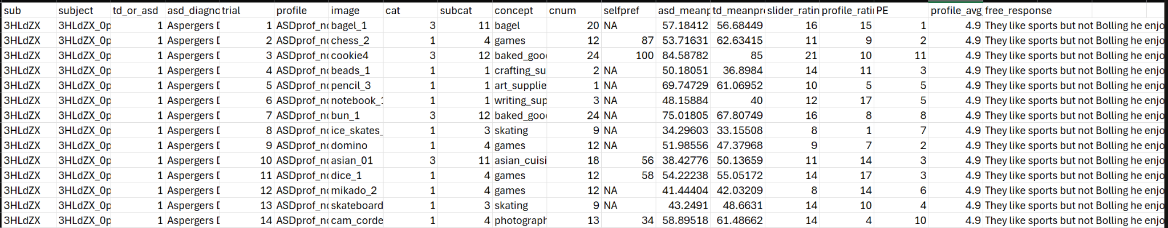
Raw Data Description - Data V1
LLM Trial Level Data .csv
1119 subjects (ages 8-12Y), 3 profiles (TDprof_norm, ASDprof_norm, or ASDprof_unif.)
Each subject has 60 trials for each profile
187,187 observations and 19 variables

Slide 7
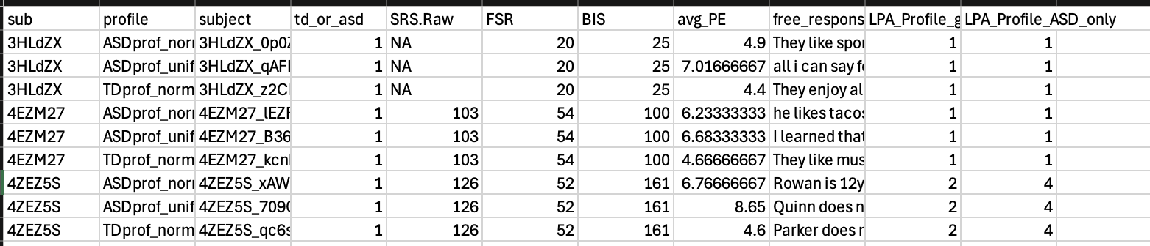
Data V2 Description - Aggregated Level (sub | profile)
LLM Data.csv
1119 subjects (ages 8-12Y), 3 profiles (TDprof_norm, ASDprof_norm, or ASDprof_unif.)
Each subject has 3 profiles (avg_PE is calculated across 60 trials for each profile)
2,648 observations and 11 variables

Slide 8
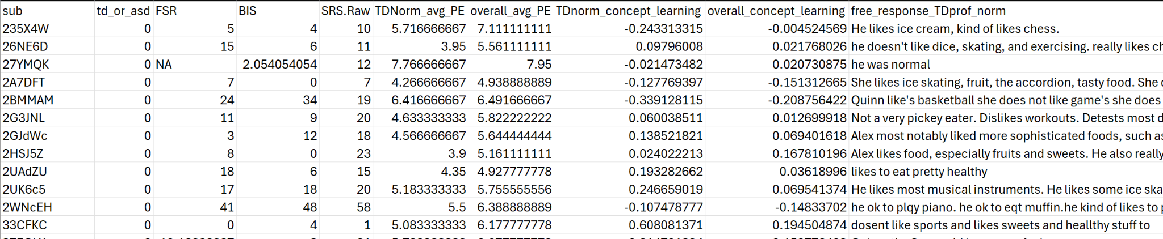
Data V3 Description - Participant Level (sub)
LLM data_aggregate_8.25.25 data_updated 10.8.25.csv
1119 subjects (ages 8-12Y), 3 profiles (TDprof_norm, ASDprof_norm, or ASDprof_unif.)
Each subject has:
  TDNorm_avg_PE: average PE for TDNorm profile
  overall_avg_PE: average PE across all 3 profiles
  TDNorm_concept_learning: slope of PE for TDNorm profile
  overall_concept_learning: slope of PE across all 3 profiles
1,119 observations and 10 variables

Slide 9
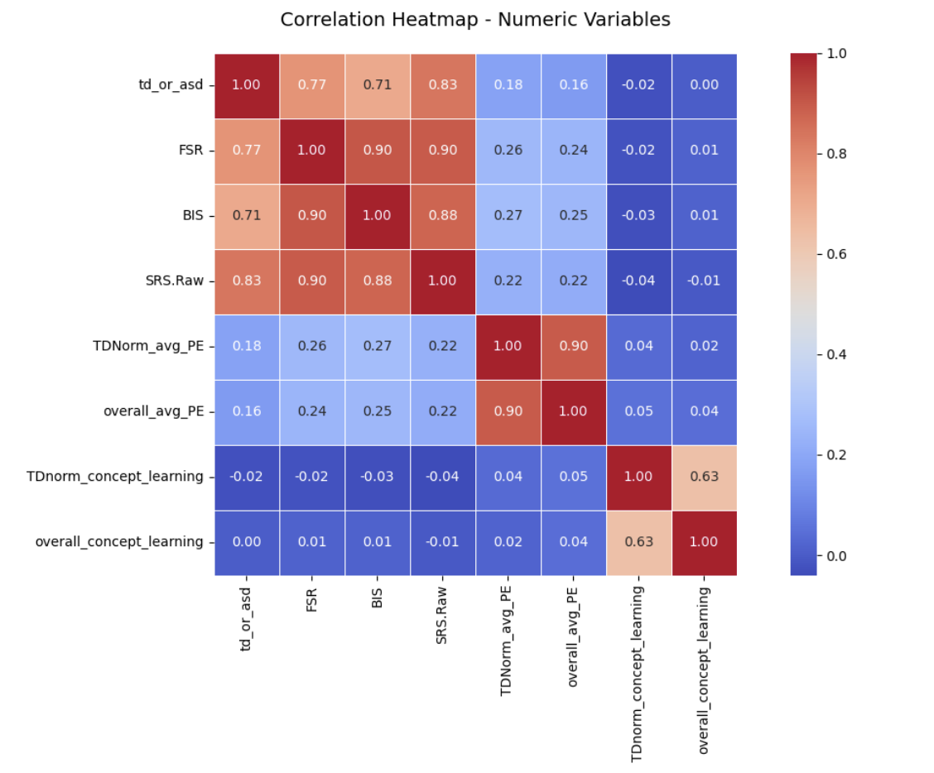
Checking Data Leakage

Slide 10
Induced Features
Characteristic features (44) : 11 characteristics
personality inference, sweets, fruits and vegetables, healthy savory food, food, cosmetics, fashion, toys, gadgets and games, sports, music, arts and crafts
NLP features (16):
word count, sentence count, readability score, positive sentiment score, etc

Slide 11
Models Summary
Model Version | Data Version | LLM Agent | Features | Train Accuracy | Test Accuracy
V1 | Data V2 | Sonnet | Sub, profile, subject, SRS.RAW, FSR, BIS, avg_PE, free_response, LPA_Profile_grand_mean, LPA_Profile_ASD_only, NLP features | 0.9159 | 0.8925
V2 | Data V2 | Sonnet | FSR, avg_PE, free_response, NLP features | 0.9150 | 0.8699
V3 | Data V2 | Qwen | FSR, avg_PE, free_response, NLP features | 0.9135 | 0.8699

Slide 12
Models Summary
Model | Data File | LLM Agent | Features | Train Accuracy | Test Accuracy
V4 | Data V2 | Hugging Face Llama | FSR, avg_PE, free_response, NLP features | 0.9072 | 0.8931
V5 | Data V2, Data V1 | Qwen | FSR, avg_PE, free_response, NLP features, slope features
V6 | Data V3 | Qwen | FSR, avg_PE, free_response, NLP features, concept learning | 0.8916 | 0.9062

Slide 13
Models Summary
Model | Data File | LLM Agent | Features | Train Accuracy | Test Accuracy
V7-1 | Data V3 | Qwen | FSR, avg_PE, free_response, NLP features, concept learning | 0.8954 | 0.8929
V7-2 | Data V3 | Qwen | Test on FSR overlap region | 1.000 | 0.4727
V7-3 | Data V3 | Qwen | Train on FSR overlap region | 0.8303 | 1.0000

Slide 14
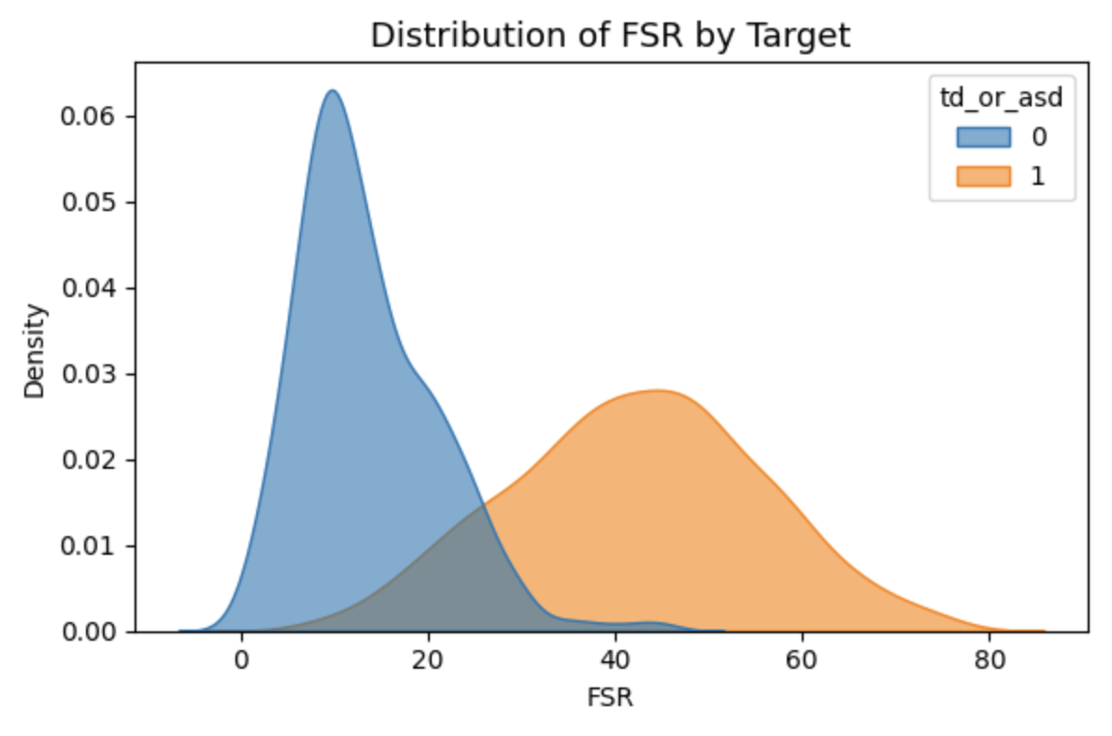
FSR Overlap Test
train
test
test
test
test
test
test
train
train
test
train
test
test

Slide 15
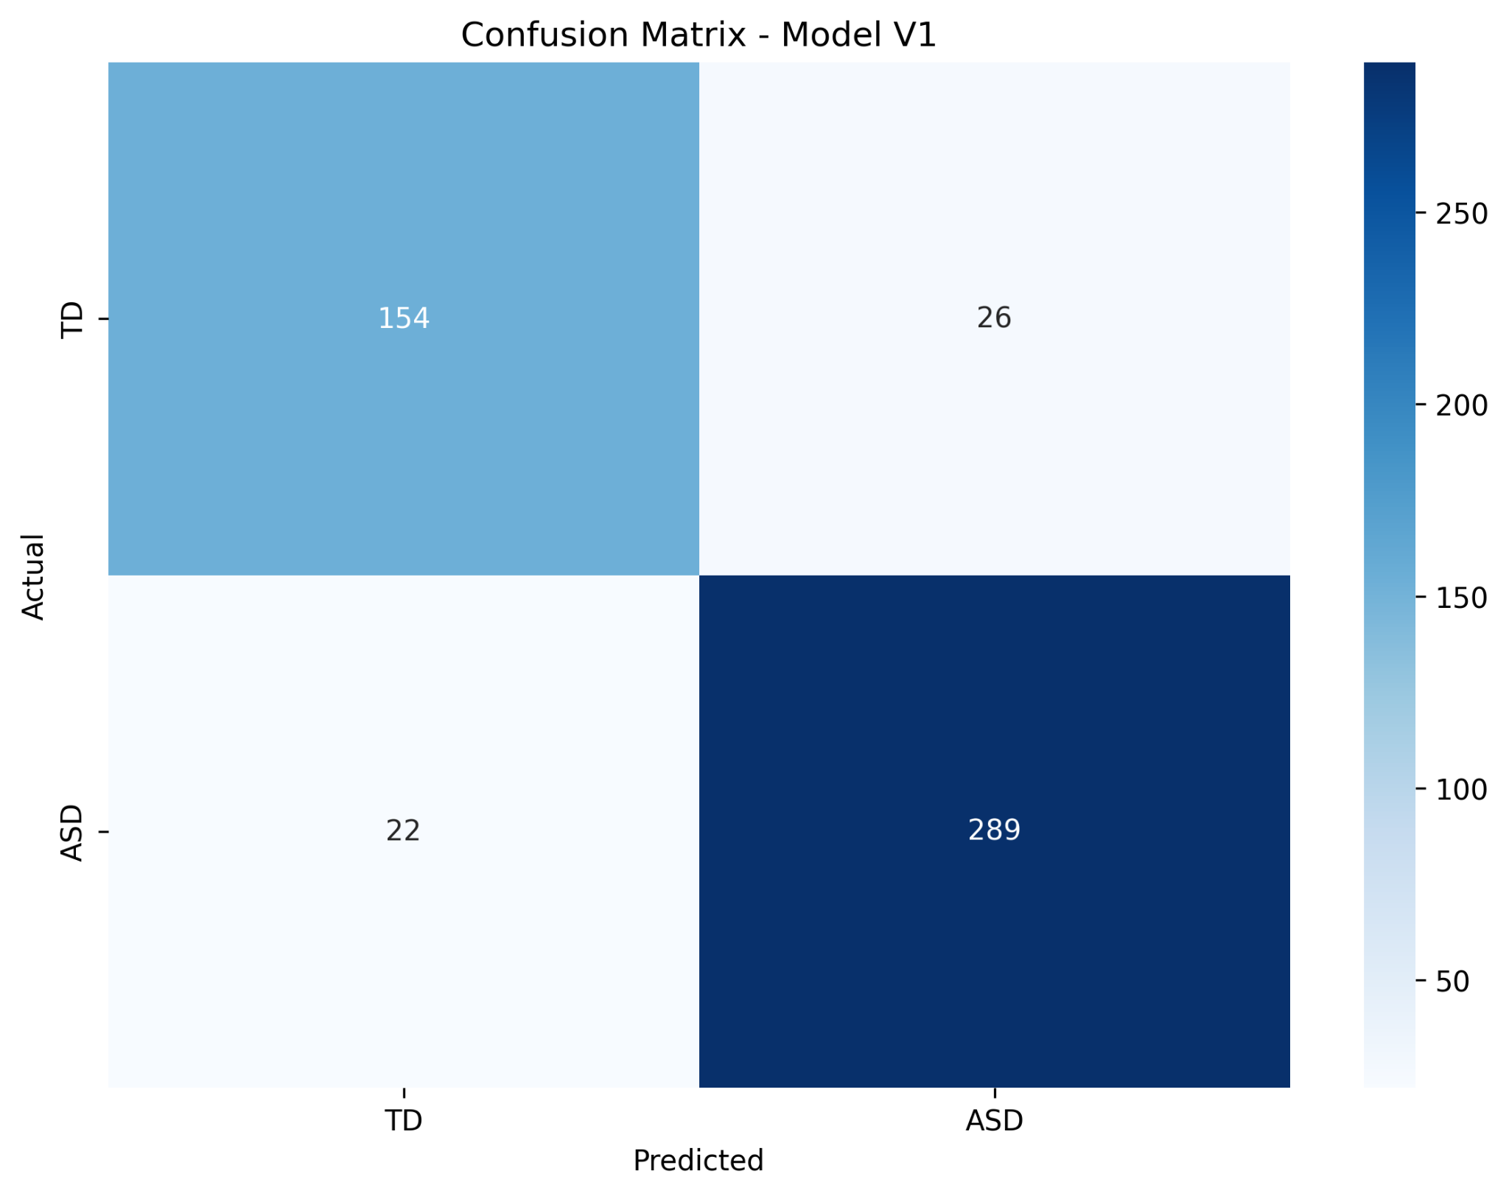
Results - V4 (Best Model) - on Data Aggregated
Hugging Face Llama 3.2 for Characteristic Feature Extraction

Slide 16
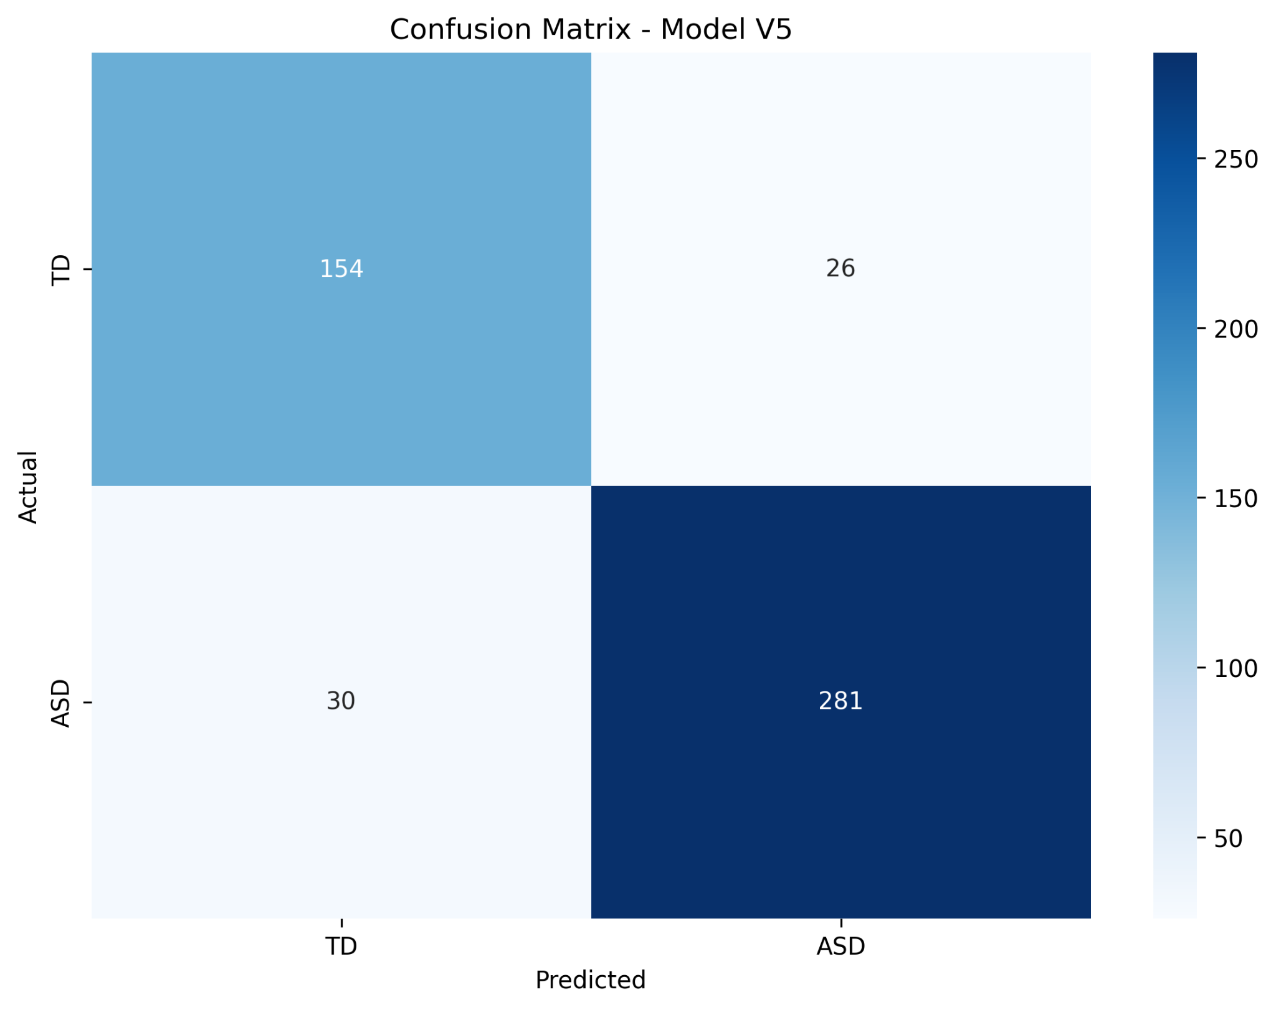
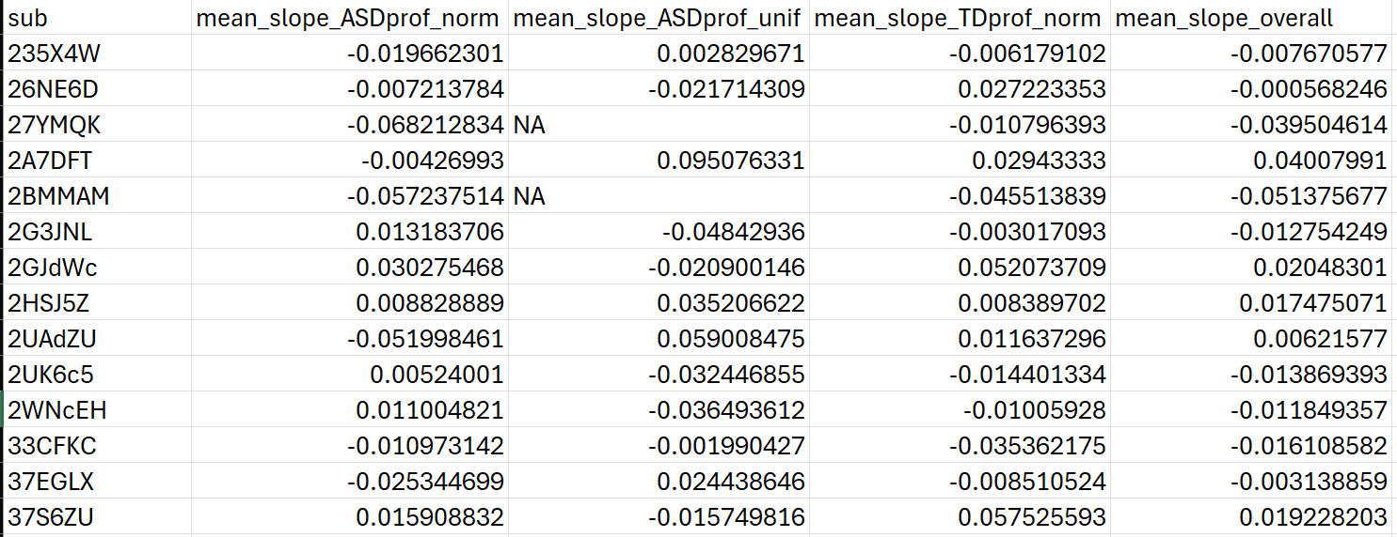
Results - V5
Using slope features calculated from “trial level data_v1_8.25.25.csv”

Slide 17
Results - V6
Agent: Qwen/Qwen2.5-0.5B-Instruct
Using concept learning features
Optuna for xgboost_model

Slide 18
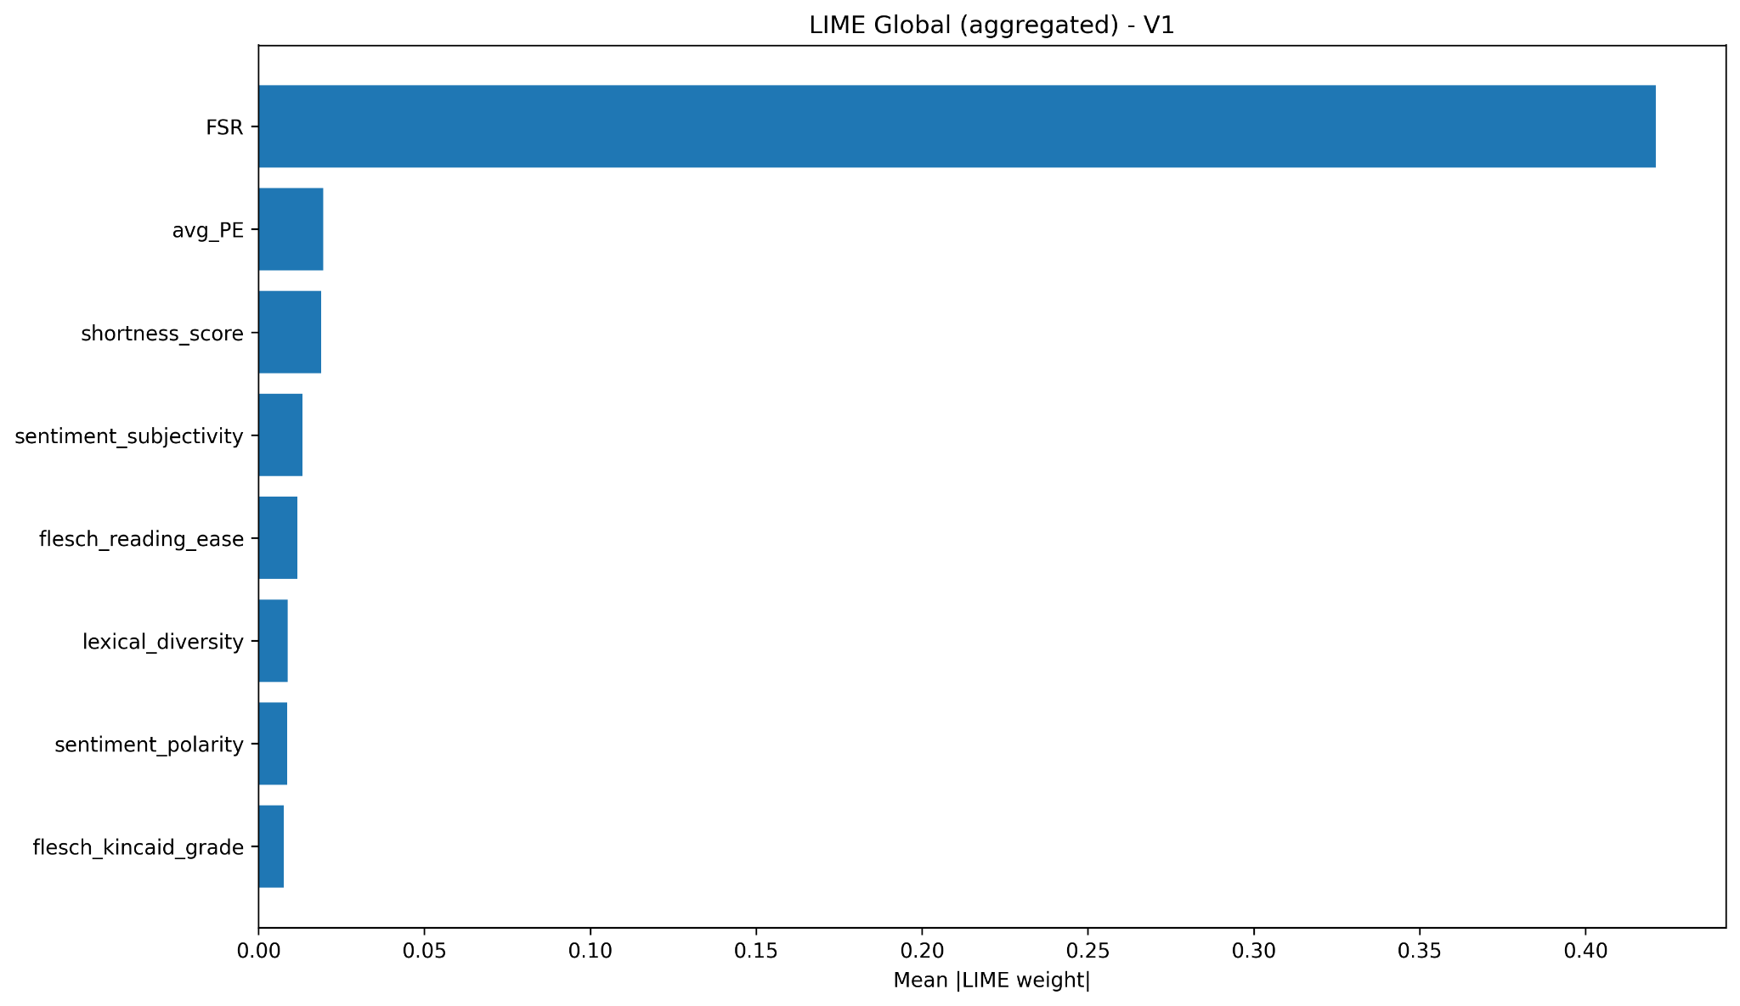
Global Explainability

Slide 19
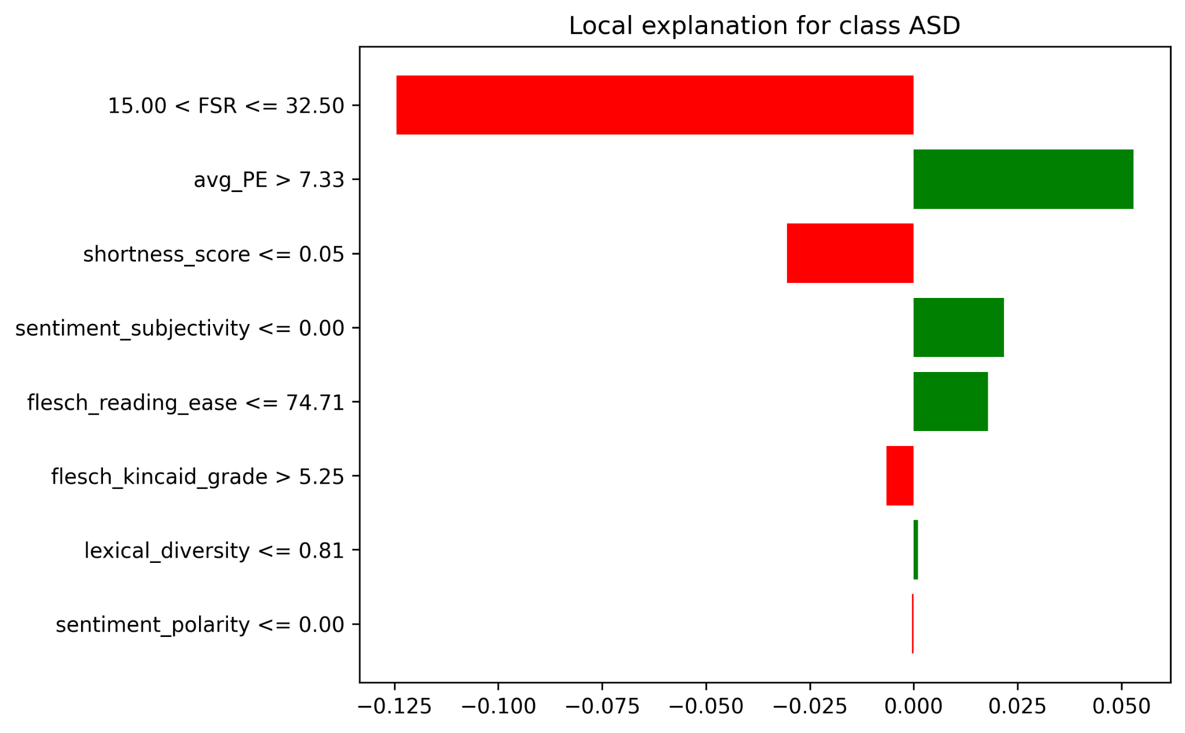
Local Explainability - row 1001 - Target 0 - TD

Slide 20
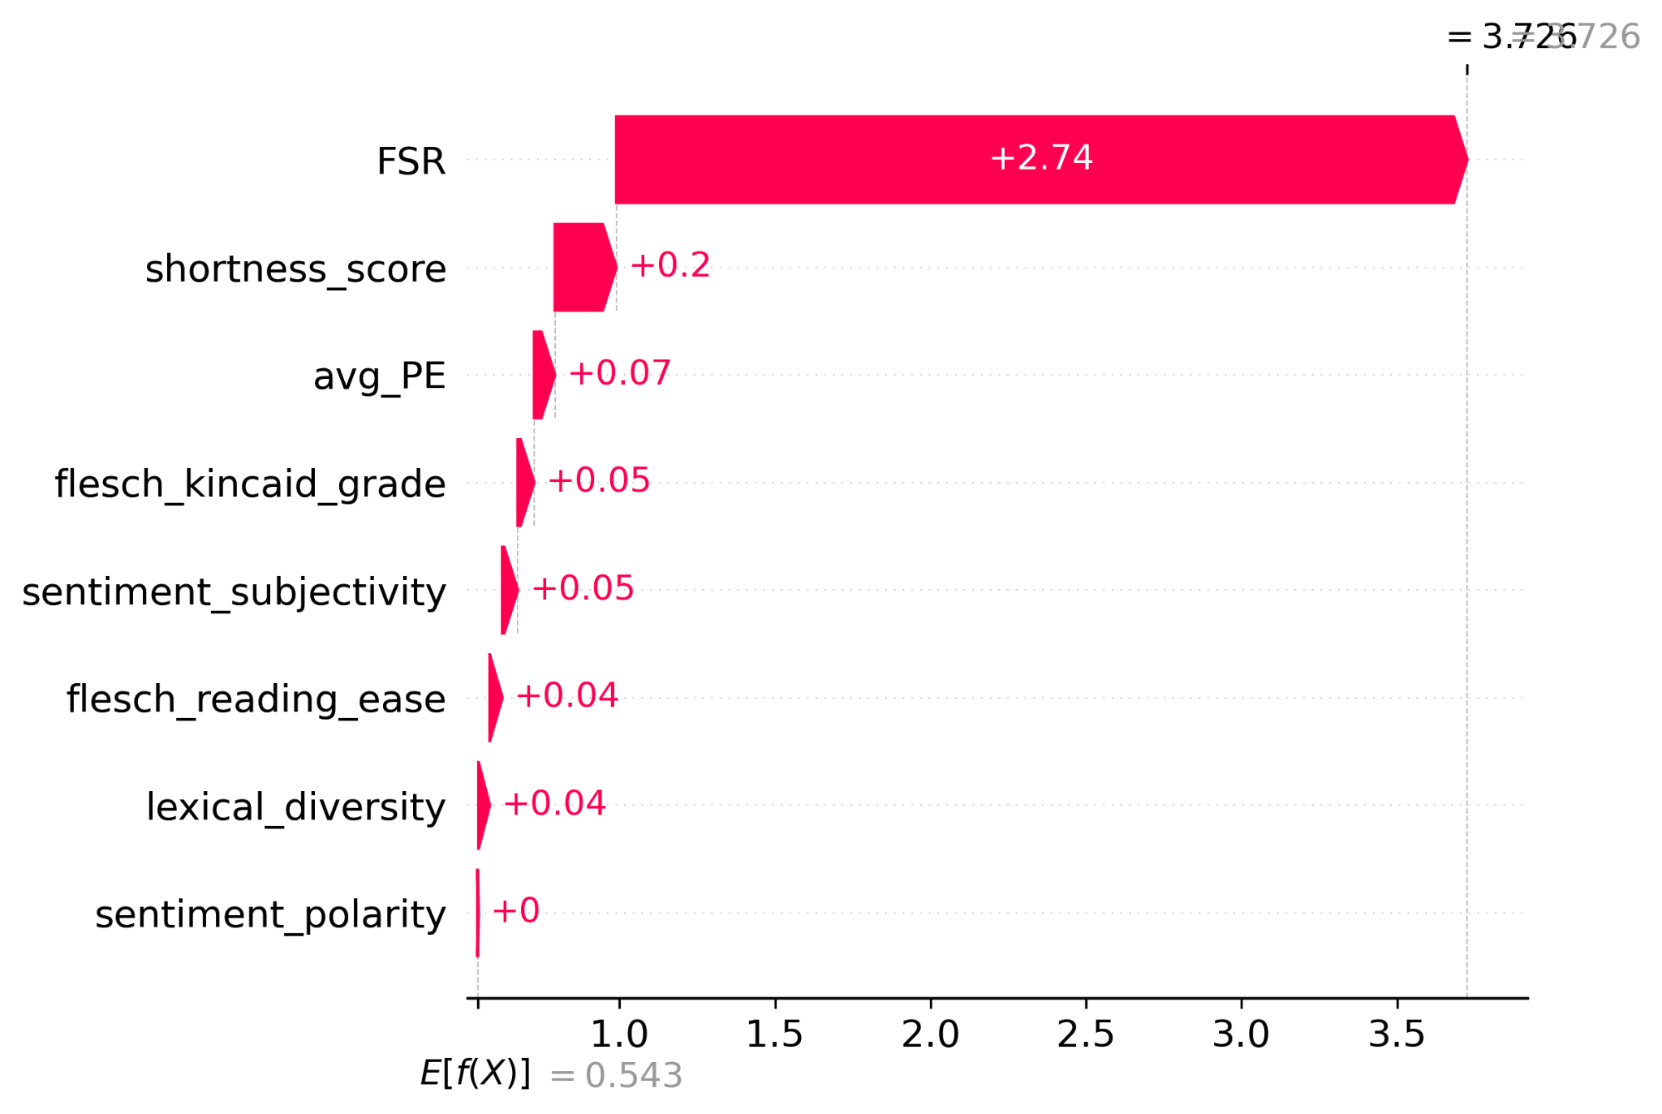
Local Explainability - row 1001 - Target 0 - TD

Slide 21
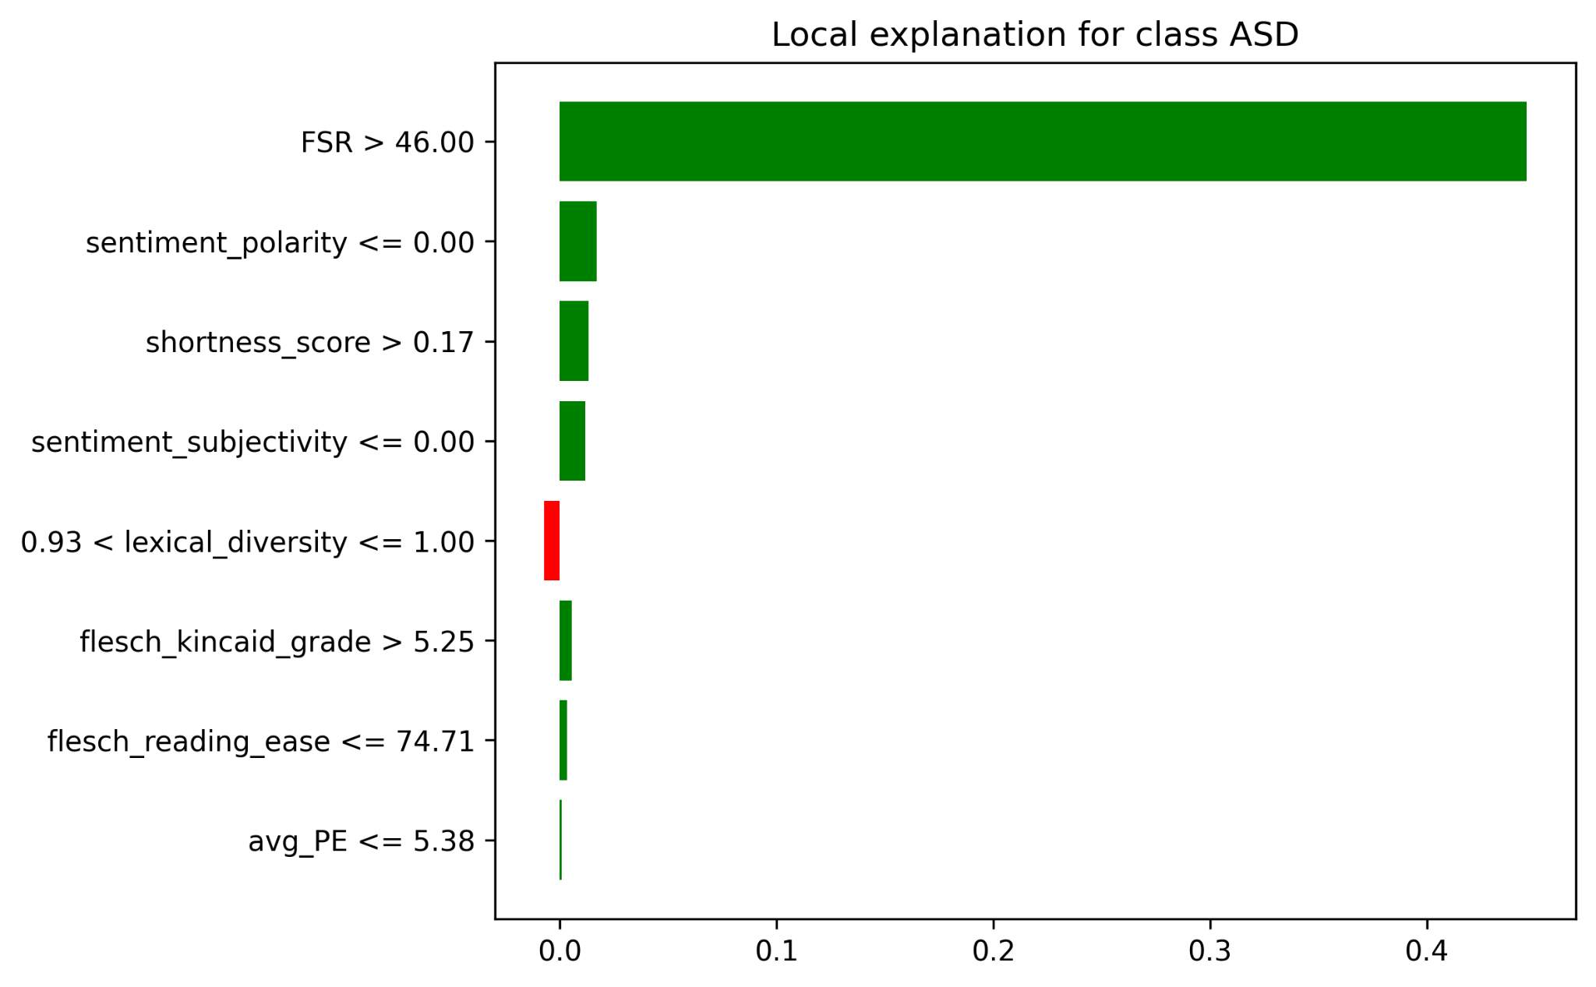
Local Explainability - row 1665 - Target 1 - ASD

Slide 22
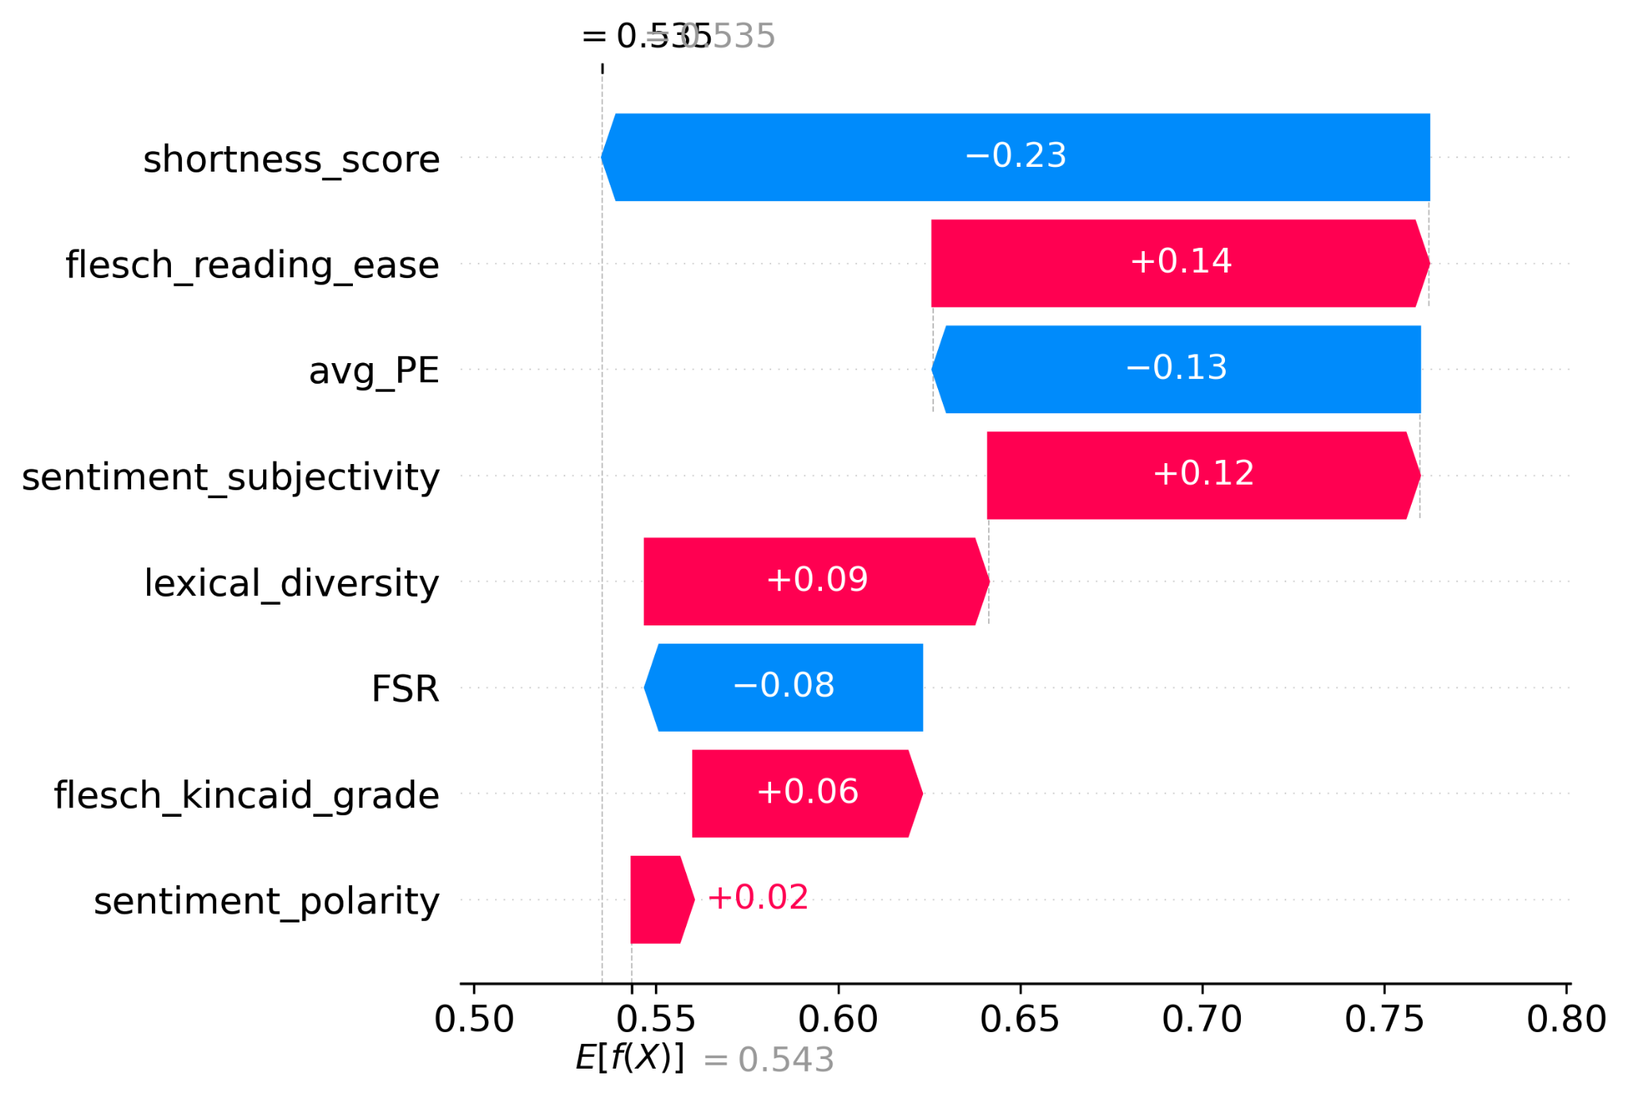
Local Explainability - row 1665 - Target 1 - ASD
Notes:
Base value (E[f(X)]) = 0.543:
This is the average model output (for example, the mean predicted probability of ASD across the dataset).
Final prediction = 0.5355:
The features pushed the prediction slightly below the average, meaning the model is slightly less confident about ASD for this sample.

Slide 23
KDE plot of FSR by Target
FSR: Flexibility Scale Revised
Higher scores indicate lower flexibility/ greater rigidity

Slide 24
Future Steps
Identify FSR overlap section between TD and ASD candidates and use that as Train/Test set to identify metrics
Identify Autism Subclusters - data approach
Modify Streamlit code to work with all versions and trials
Feature Importance Code needs to be modified for the TD ASD comparisons
Look at BERT Embeddings for text data to replace Characteristics

